Slide 1
D3 Alternatives to Data Visualization
- Hrishi Gadkari

Slide 2
Overview
D3 Limitations
Graph Visualizations
Three Dimensional
Charts Visualizations
Summary

Slide 3
D3 Limitations
Might not be perfect for every project
Sometimes you just need a quick chart
You don’t have time to code it from scratch
You might need to support older browsers
Can’t rely on recent technologies like SVG.
Notes:
For those situations, it’s good to know what other tools are out there. Here is a brief, noncomprehensive list of D3 alternatives, all of which use web-standard technologies (mostly JavaScript) and are free to download and use.

Slide 4
Graph Visualizations
Arbor.js
A library for graph visualization using jQuery
You can use it with canvas, SVG, or even positioned HTML elements
<script src="path/to/jquery.min.js"></script> <script src="path/to/arbor.js"></script>
Sigma.js
JavaScript library to display graphs
Develop highly interactive Web applications that show graph visualizations
<script src="path/to/sigma.js"></script>
Notes:
whatever display approach is appropriate for your project and your performance needs.

Slide 5
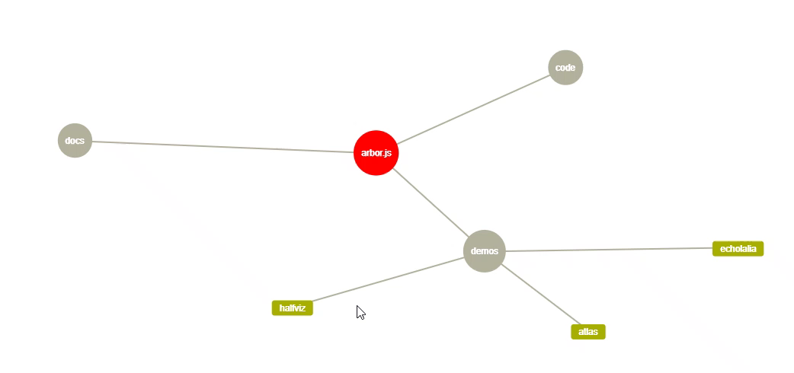
Arbor.js

Slide 6
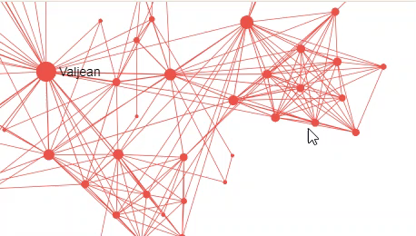
Sigma.js

Slide 7
Three Dimensional
Three.js
WebGL compatibility
A library for generating any sort of 3D scene you could imagine
Produced by Google’s Data Arts team
<script src="js/three.js"></script>
<script> // Javascript will go here. </script>
PhiloGL
PhiloGL is built on JavaScript providing an expressive and powerful API
Function webGLStart() {
//Create Earth
//Create Application
PhiloGL(canvasId, options)
}
Notes:
D3 is not the best at 3D, simply because web browsers are historically two-dimensional beasts. But with increased support for WebGL, there are now more opportunities for 3D web experiences.
WebGL (Web Graphics Library) is a JavaScript API for rendering interactive 2D and 3D graphics within any compatible web browser without the use of plug-ins
WebGL is widely supported in modern browsers. However its availability is dependent on other factors like the GPU supporting it.

Slide 8
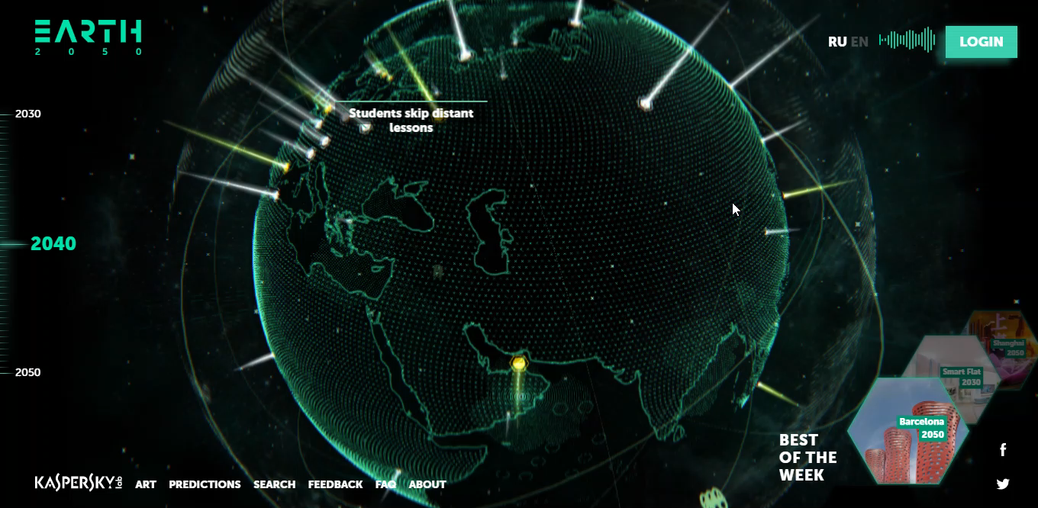
Three.js

Slide 9
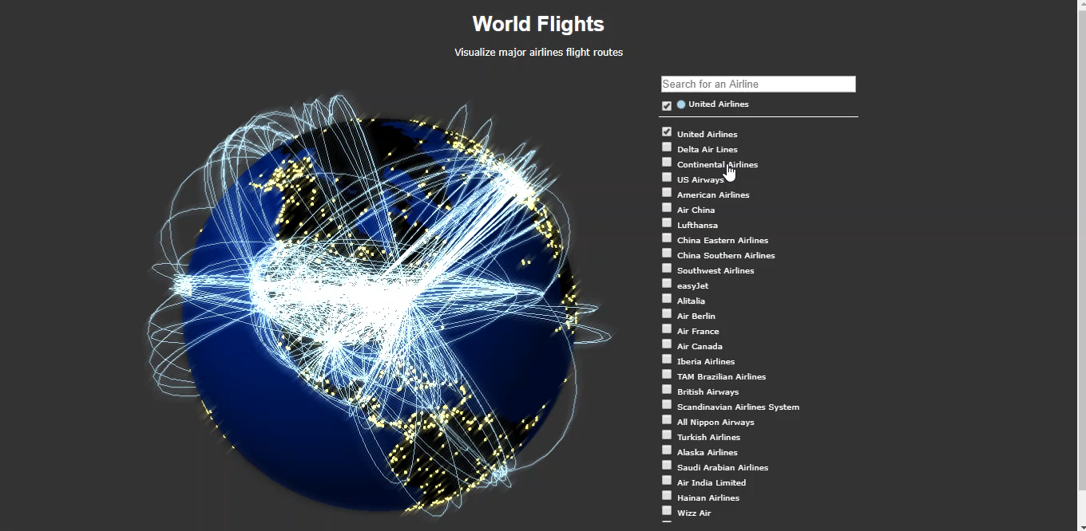
PhiloGL

Slide 10
Charts or Graphs
JavaScript InfoVis Toolkit
Its API allows you more easily/directly create some shapes or layouts
Easier to learn and implement a solution for a one-time project including a TreeMap or Graph
<script src="../../jit.js"></script>
var element = $jit.id('elementId')
Highcharts JS
A JavaScript-based charting library with several predesigned themes and chart types
<script src="https://code.highcharts.com/highcharts.js"></script>
Notes:
Its library and utility functions is not as extensive as D3

Slide 11
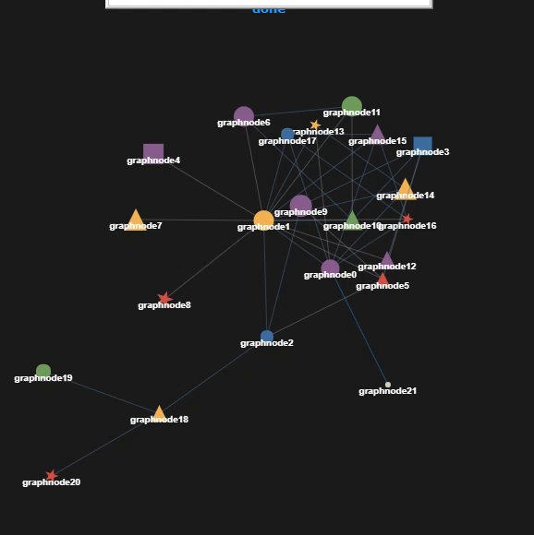
JavaScript Infovis Toolkit – Force Directed Graph

Slide 12
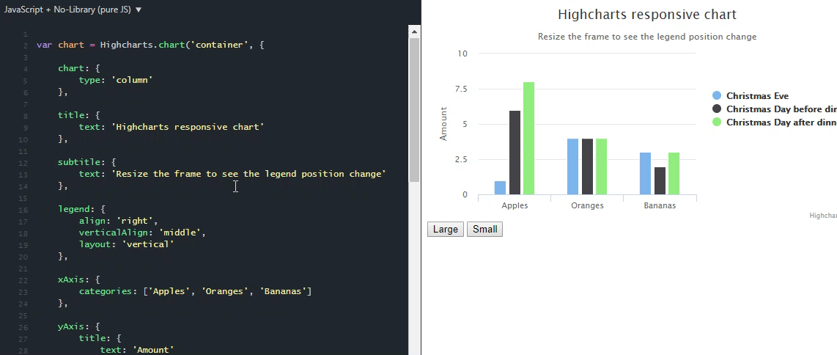
Highcharts JS

Slide 13
Summary
So far we have seen a brief, non-comprehensive list of D3 alternatives, all of which use web-standard technologies (mostly JavaScript) and are free to download and use
To have a look at some more alternatives, you can visit the following website:
http://ejparthds.blogspot.com/2015/02/d3-alternatives.html

Slide 14
Thank You, Any Questions?

